Slide 1
PIANOLA RESULTS:
RESULTS TABLE
TRAVELLERS
PLAYING YOUR HAND AGAIN

Slide 2
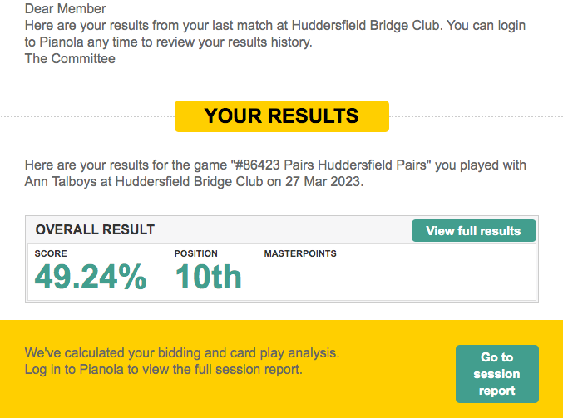
OPEN your email to see a message similar to the above.
CLICK on View full results.

Slide 3
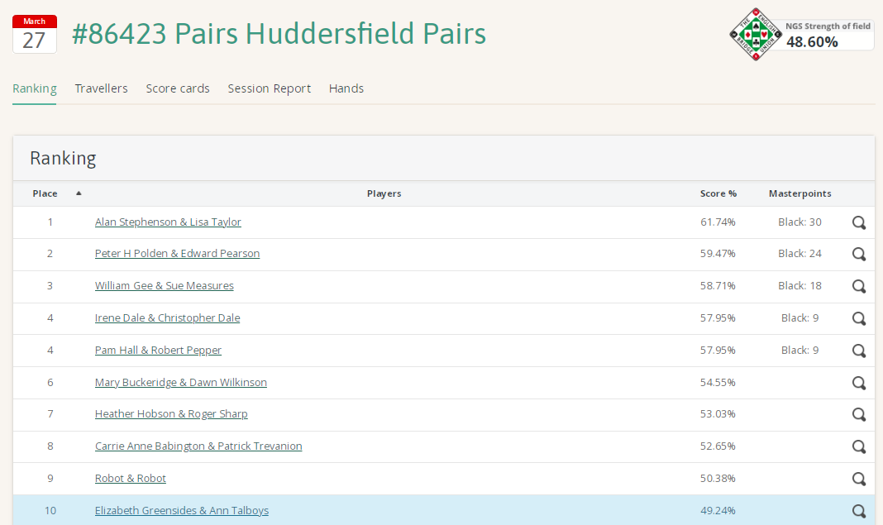
The results table will appear, as above.
Just above the table you will see a horizontal list. CLICK on Hands.

Slide 4
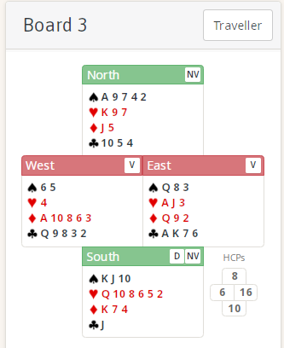
You can then look at any of the boards which you played during the session.

Slide 5
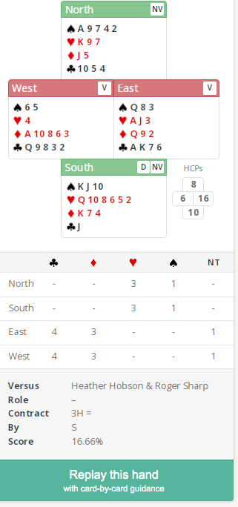
If you were playing online, your bidding will also be shown.

Slide 6
CLICK on the Replay this hand tab to …. Replay this hand.

Slide 7
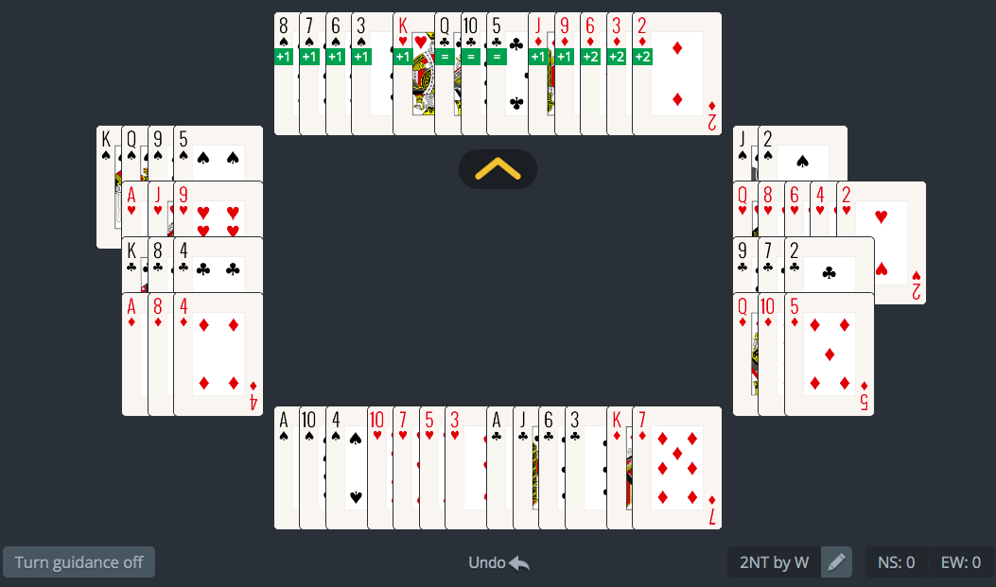
Play the hand again with, or without guidance.

